Slide 1
Simple Functions
Week – 7

Slide 2
Java 8
Libraries introduced in Java 8 made it possible to write programs in a functional or declarative style.
Prior to that, only state-based object-oriented programming was supported.
State-based refers to static programming (basic arithmetic operations, printing messages to the console).
While dynamic programming is flexible solving complex optimization problems.
Functional programming views computation as the evaluation of mathematical type functions.

Slide 3
Java 8
What does the function do? (arithmetic operations, comparison operation min, max, etc.)
How to write a program in a functional way or declaration. We will look into the lambda function.

Slide 4
Why Functional Programming?
Imperative functions:
Imperative functions can have side effects that may change the value of the program state. Because of this, they lack referential transparency.
For example, the same language expression can result in different values at different times depending on the state of the executing program.
Imperative functions may have side effects, meaning they can modify external state, perform I/O operations, or interact with the outside world in ways that are observable from other parts of the program.

Slide 5
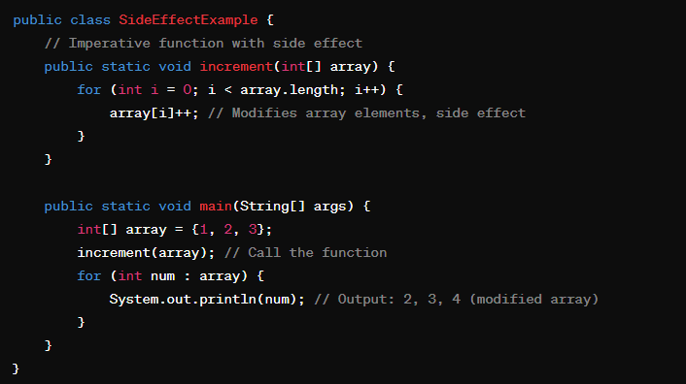
Why Functional Programming?
In this Java example, the increment function modifies the elements of the input array, array, which is a side effect. When the increment function is called, it changes the state of the array, and subsequent operations on the array will reflect this change.

Slide 6
Why Functional Programming?
Mathematical Functions:
The output value of a function depends only on the arguments that are input to the function.
A function always returns the same result when supplied with the same argument values.
A function never modifies its arguments
Mathematical functions in functional programming do not have side effects. They do not modify external states or variables, perform I/O operations, or have any observable interactions with the outside world.

Slide 7
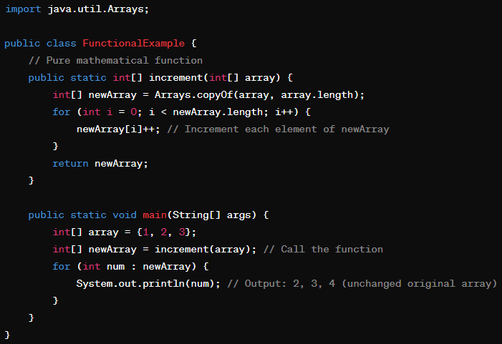
Why Functional Programming?
In this Java example, the increment function takes an array as input, creates a new array with the incremented values, and returns the new array. The original array remains unchanged, and there are no side effects. This behavior aligns with the principles of functional programming, where functions are treated as mathematical objects and exhibit referential transparency.

Slide 8
Functional Programming
Advantages of functional Programming:
Eliminates side effects: to make it much easier to understand and predict the behavior of a program.
Views computation as the evaluation of mathematical functions.
Avoids the notion of state and mutable data: discourage changing the state of variables or data structures after they are initialized.
Advantages – reduce complexity, big O

Slide 9
Lambda Expression
A function is a definition that associates a set of input parameters with a single output parameter.
We write functions using what are called Lambda Expressions.
The syntax for a lambda expression is a list of parameters, in parentheses, a right arrow, and then the body of the function that may or may not be enclosed in curly brackets
Example – Lambda Expression:
(parameter list) → body of function
(parameter list) → { body of function; return ?;})

Slide 10
Lambda Expression
Syntax
(parameter list) (list, int, double, char) → (tends to) body of the function (any arithmetic operation, increment, decrement).
(parameter list) -> { body of function; return ?;} (curly brackets only if we are including loop, iteration, etc.)
Example
(Integer x) -> x + 1 //If x is 5, returns 6

Slide 11
Lambda Expression
Example – 1: (Integer x) -> x % 2 == 0
(Integer x): This part declares the input parameter x of type Integer.
This arrow symbol separates the parameter list from the body of the lambda expression.
x % 2 == 0: This is the body of the lambda expression. It calculates the remainder of x divided by 2 using the modulus operator %, and then checks if the remainder is equal to 0. If the remainder is 0, it returns true, indicating that x is even; otherwise, it returns false.
Example – 2: (Integer x, Integer y) -> x + y

Slide 12
Lambda Expression
Example – 3:(Integer x) -> x >= 0 ? x : -x
If x is greater than 0, return x, otherwise return –x.
Example – 4:
(Integer n) -> {
int s = 0;
for(int j = 0; j < n; j++) s = s +(j+1);
return s; for loop.
} //Calculates the sum of the first n natural numbers
The fourth example is enclosed by curly brackets and has an explicit return statement.
When the definition of a lambda expression requires more than a single expression it must be enclosed by curly brackets.

Slide 13
Lambda Expression
Note the expression
(Integer x) -> {if(x > 0) return true;}
If a lambda expression requires the use of an if statement to determine its result, then it must return a value for each branch of the if statement.
If you define only 1 condition, it becomes invalid.
Must write as:
(Integer x) -> {if(x > 0) return true; else return false;}
you need to return something

Slide 14
Lambda Expression
It is also possible to write an expression that takes no arguments and may or may not return a value. For example, the expression.
() -> {for(int j = 0; j < 10; j++) System.out.println(j);}
takes no argument and simply executes the action; print the numbers 0 to 9 inclusive. It does not return a value.

Slide 15
Lambda Expression
In Java, Lambda expressions are implemented by different functional interfaces.
Java is not a functional programming language; they are implemented using specific interfaces where the interface declares its intent.
Each functional interface has a specific signature and a single abstract method used to invoke it.
There are a number of different functional interfaces defined in the package java.util.function and we will discuss the different ones in detail later.
The semantics of a function are defined by a lambda expression.

Slide 16
Lambda Expression
Creating your own functional interface and using the lambda expression…
16

Slide 17
Java.util.function Package
Interfaces
Function<T,R>
Takes a single argument of type T and has return type R
T can be any type – i.e., int, char, string
BiFunction<T,U,R>
Takes two arguments of type T and U and has return type R
Each of these has a single abstract method called apply that is implemented by a given lambda expression

Slide 18
Functions
The following code block assigns each of our lambda expressions to appropriately named variables. Each one has a single argument and a specific return type.
Function<Integer T, Integer R> inc (function) = x -> x + 1;
Function<Integer,Boolean> even = x -> x % 2 == 0;
Function<Integer,Boolean> pos = x -> x > 0;
Function<Integer, Integer> abs = x -> x >= 0 ? x : -x;
We are defining all this in the interface not in the main method like previously. This is the main difference.

Slide 19
Functions
Function<Integer,Integer> sum = n -> {
int s = 0; for(int j = 1; j <= n; j++) s = s + j;
return s;
};
BiFunction<Integer,Integer,Integer> add = (x,y) -> x + y; // < T, T, R >

Slide 20
apply method
A function value is an object just like any other object. We invoke the function instance by referencing its apply method as you would for any other object instance.
System.out.println(inc.apply(7));
System.out.println(even.apply(9));
System.out.println(pos.apply(-9));
System.out.println(abs.apply(-7));
System.out.println(sum.apply(10));
System.out.println(add.apply(3,5));

Slide 21
assert
Assert uses a Boolean expression and throws an exception if the result is false.
assert inc.apply(7) == 8;
assert even.apply(9) == false;
assert pos.apply(-9) == false;
assert abs.apply(-7) == 7;
assert sum.apply(10) == 55;
assert add.apply(3,5) == 8; //here, we don’t have to write another program to enter the value of x and y. rather, we only use the apply method.

Slide 22
sumLst
We can also write functions that take data structures as arguments and that return information about the state of the given data.
Function<List<Integer>,Integer>
sumLst = lst ->{
int s = 0;
for(Integer x : lst) s = s + x;
return s;
};
The function sumLst takes a list of integer values and calculates the sum of the elements in the list.
Each of the functions uses a for loop to process the data and is coded in an imperative style.

Slide 23
sumLst
Function<List<Integer>,Integer>
sumLst = lst ->{
int s = 0;
for(Integer x : lst) s = s + x;
return s;
};
Note that here all coding of function bodies will be done in an imperative style. It is also possible to write them in a declarative or functional style using what are called streams.
The function, sumLst, returns 0 if the list is empty. This is correct because, from a mathematical perspective, the sum of an empty list is defined to be 0.

Slide 24
allPos
Function<List<Integer>,Boolean>
allPos = lst ->{
for(Integer x : lst) if(x <= 0) return false;
return true;
};
The function allPos takes a list of integer values as argument and returns true if all the elements are positive values; false otherwise.
It returns true if the list is empty.

Slide 25
freq
BiFunction<Integer,List<Integer>,Integer>
freq = (k,lst) ->{
int count = 0;
for(Integer x : lst) if(k.equals(x)) count++;
return count;
};
Freq takes both a list of integer values and an integer value as arguments and calculates the frequency of occurrence of the number in the list.
Here, we are counting the elements in the list with the same logic as the singly linked list length-finding program. If the freq matches the value of k, then returns count.

Slide 26
getLst
Function<Integer,List<Integer>>
getLst = n ->{
if(n < 0) return new ArrayList<Integer>();
List<Integer> lst = new ArrayList<Integer>(n);
for(int j = 0;j < n; j++)
lst.add((int)(Math.random()*n)); //adding random elements.
return lst;
};
The function getLst demonstrates how to write a function that returns a data structure.
It takes an integer n as an argument and returns either an empty list, n <= 0, or a list of n values initialized to numbers in the range 1..n.

Slide 27
Testing
The following code fragment uses an assert statement to test each of these functions
List<Integer> dt = new ArrayList<Integer>(Arrays.asList(1,2,3,4,5)); list as input
assert sumLst.apply(dt) == 15;
assert allPos.apply(dt) == true;
assert freq.apply(6,dt) == 0;
//here we are checking the frequency of 6. 6 is not present here, so 0. If there is 3 then it will return.

Slide 28
Identity Mapping
An identity mapping simply returns its argument value, and it is equivalent to the lambda expression x -> x.
This method is a static method implemented as part of the interface for Function<T,R>.
You can create an alias for it, called id below, or you can use it directly by invoking Function.identity().
Function<Integer,Integer> id = Function.identity();
assert id.apply(7) == 7;
assert Function.identity().apply(7).equals(7);
assert Function.identity().apply("happy").equals("happy");

Slide 29
Special Functions
Supplier<T>
Consumer<T>
BiConsumer<T,U>
UnaryOperator<T>
BinaryOperator<T>
Predicate<T>
BiPredicate<T>

Slide 30
Supplier<T>
Takes no arguments and returns the value of type T.
Supplier has only 1 argument, which is the return type, and it takes no input.
Example: Method name for function application is: get

Slide 31
Supplier – Example
Supplier<Doublereturn > ran (function) = () → Math.random();
Supplier<List<Integer>> newLst = () → new ArrayList<Integer>();
ran that returns a random decimal value.
newLst that returns an empty ArrayList of type integer.
A code fragment to test them might be:
Double k = ran.get();
assert newLst.get().size() == 0;
whatever we receive from the get method will be returned in a double format.

Slide 32
Consumer<T>
Takes a single argument of type T and has no return value.
This means that it effectively accepts a value that it consumes.
Example: Method name for application is: accept

Slide 33
Consumer<T>
printS that take a String as an argument simply prints i.
Consumer<String> printS = s -> System.out.println(s);
printSum that takes a list of integers as argument, calculates their sum, and outputs the result.
Consumer<List<Integer>> printSum = lst ->{
int s = 0;, for(Integer x : lst) s = s + x;
System.out.println("Sum: "+s);
};

Slide 34
Consumer<T>
A code fragment to test them might be:
List<Integer> dt = new instance ArrayList<Integer>(Arrays.asList(1,2,3,4,5));
printS.accept("Happy days are here again");
printSum.accept(dt);

Slide 35
UnaryOperator<T>
Takes argument of type T and returns value of type T
Method name for application: apply
Special instance of Function<T,R>

Slide 36
UnaryOperator<T>
copy that takes a list of integer values as an argument and returns a new list.
UnaryOperator<List<Integer>> copy = lst ->{
List<Integer> ls = new ArrayList<Integer>();
for(Integer x : lst) ls.add(x);
return ls;
};

Slide 37
BinaryOperator<T>
Takes two arguments of type T and returns value of type T
Method name for application: apply
Special instance of BiFunction<T,U,R>

Slide 38
BinaryOperator<T>
concat that takes two strings as arguments and returns a concatenated string.
BinaryOperator<String> concat = (s1,s2) -> s1 + s2;
The BinaryOperator function has two static methods
maxBy: that returns the greater of two elements according to a specified Comparator.
minBy: that returns the lesser of two elements according to a specified Comparator.
Both take the Comparator as an argument.

Slide 39
BinaryOperator<T>
The function minComp takes a two valued lambda expression as argument.
This expression uses the Comparator from the Integer class and returns the lesser element of its argument values.
The assert statement is used to check the result.
BinaryOperator<Integer> minComp;
minComp = BinaryOperator.minBy(
(x,y) -> Integer.compare(x,y));
assert minComp.apply(4,7) == 4;

Slide 40
BinaryOperator<T>
Comparator<Integer> cmp = (x,y) -> Integer.compare(x,y);
BinaryOperator<Integer> maxComp = BinaryOperator.maxBy(cmp);
System.out.println(maxComp.apply(4,7));
assert maxComp.apply(4,7) == 7;

Slide 41
Predicate<T>
Takes a single argument of type T and returns a Boolean value
Method for application: test

Slide 42
Predicate<T>
odd that takes an integer as argument and returns true if it is an odd value, false otherwise;
existsOdd that takes a list of integers returning true if it contains an odd value, false otherwise.
Predicate<Integer> odd = x -> x % 2 != 0;
Predicate<List<Integer>> existsOdd = lst ->{
for(Integer x : lst) if(odd.test(x)) return true;
return false;
};

Slide 43
Predicate<T>
We test these predicates with the following code fragment that uses the assert statement.
List<Integer> dt = new ArrayList<Integer>(Arrays.asList(1,2,3,4,5));
assert odd.test(7) == true;
assert existsOdd.test(dt) == true; no need of else condition if odds exists

Slide 44
BiPredicate<T,U>
BiPredicate takes two arguments, not necessarily of the same type.
BiPredicate<Integer,List<Integer>> contains =(x,lst) -> lst.contains(x);
assert contains.test(7,dt) == false; checking if 7 exists

Slide 45
Higher-Order Functions
Functions that take other functions as parameters or that return them as results are called higher-order functions.
Example:
Function that itself takes an integer argument and returns an integer, and an integer argument. This higher-order function is a BiFunction because it takes two arguments.
the Function<Integer,Integer> and its argument Integer. The function is aptly called hFunc.
The function simply returns the result of invoking function f with argument x. The result returned will depend on the meaning of function f.
BiFunction<Function<Integer,Integer>,Integer,Integer> hFunc = (f, x) -> f.apply(x);
System.out.println(hFunc.apply(x -> x + 1, 3) ); x is 1st input, 3 is 2nd input
System.out.println(hFunc.apply(x -> 2 * x + 10, 3));
Notes:
The function simply returns the result of invoking function f with argument x. The result returned will depend on the meaning of function f.

Slide 46
Higher-Order Functions
assert hFunc.apply(x -> x + 1, 3) == 4;
assert hFunc.apply(x -> x + 1, 10) == 11;
assert hFunc.apply(x -> 2 * x + 10, 3) == 16;
assert hFunc.apply(x -> x < 0 ? -x : x, -5) == 5;
assert hFunc.apply(intSqrt,15) == 3;

Slide 47
ArrayList Methods
In Java 8 four new methods have been added to the ArrayList class.
These methods are higher-order methods.
They take specialized functions as arguments and apply them automatically to all the elements in the given list.

Slide 48
ArrayList Methods that use Functions
 | Method | Meaning
void | forEach(Consumer<? super E> action) | Applies the given action function to all the elements in the list in order.
boolean | removeIf(Predicate<? super E> filter) | Removes all values that satisfy the given predicate filter
void | replaceAll(UnaryOperator<E> op) | Replaces each element of this list with the result of applying the operator function op to that element.
void | sort(Comparator<? super E> cmp) | Sorts this list according to the order specified by the given Comparator cmp.

Slide 49
forEach
The method forEach provides an internal iterator that takes a Consumer function as an argument and applies this function to each element in the sequence provided by the internal iterator for the class.
It removes the necessity to write an external loop
Example:
for(Integer x : lst) System.out.print(x+" ")
can be replaced with
lst.forEach(x->System.out.print(x+" "))
Because this method takes a Consumer function as an argument it frees the user from writing the iteration code and allows the programmer to focus on what they want the consumer to do.

Slide 50
forEach
The program listed below gives an example of doing just this.
We write a consumer function, printEven, that takes an integer as argument and prints it only if it is an even number. This function is then passed as argument to the forEach method.
Consumer<Integer> printEven = x->{
if(x % 2 == 0) System.out.print(x+" ");
};
lst.forEach(printEven);

Slide 51
removeIf
The removeIf method is also a higher order method because it takes a Predicate function as argument and removes from the given list only those values that satisfy the given predicate.
Example:
To remove all values greater than 10 we simply write
lst.removeIf(x -> x > 10)

Slide 52
replaceAll
Method replaceAll takes a UnaryOperator function as argument and applies it to each element in the list.
This method has the side effect of modifying each value in the given list.
lst.replaceAll(x-> x*x);
System.out.println(lst);

Slide 53
sort
Finally, the sort method takes a Comparator and sorts the elements in order defined by the compare method provided by it.
//examples of sort with comparator
lst.sort((x,y)->Integer.compare(x,y));
System.out.println(lst);
Comparator<Integer> gt = (x,y) -> -1*Integer.compare(x,y); // descending
lst.sort(gt);
System.out.println(lst);

Slide 54
Exercise
Write a Java program that generates a random integer between 1 and 100 using the Supplier<T> functional interface.
Write a code that generates a random password based on the length entered by the user. The password should consist of alphanumeric characters (uppercase, lowercase) and digits. Implement the program using the Supplier<T> functional interface to generate random characters.

